Slide 1
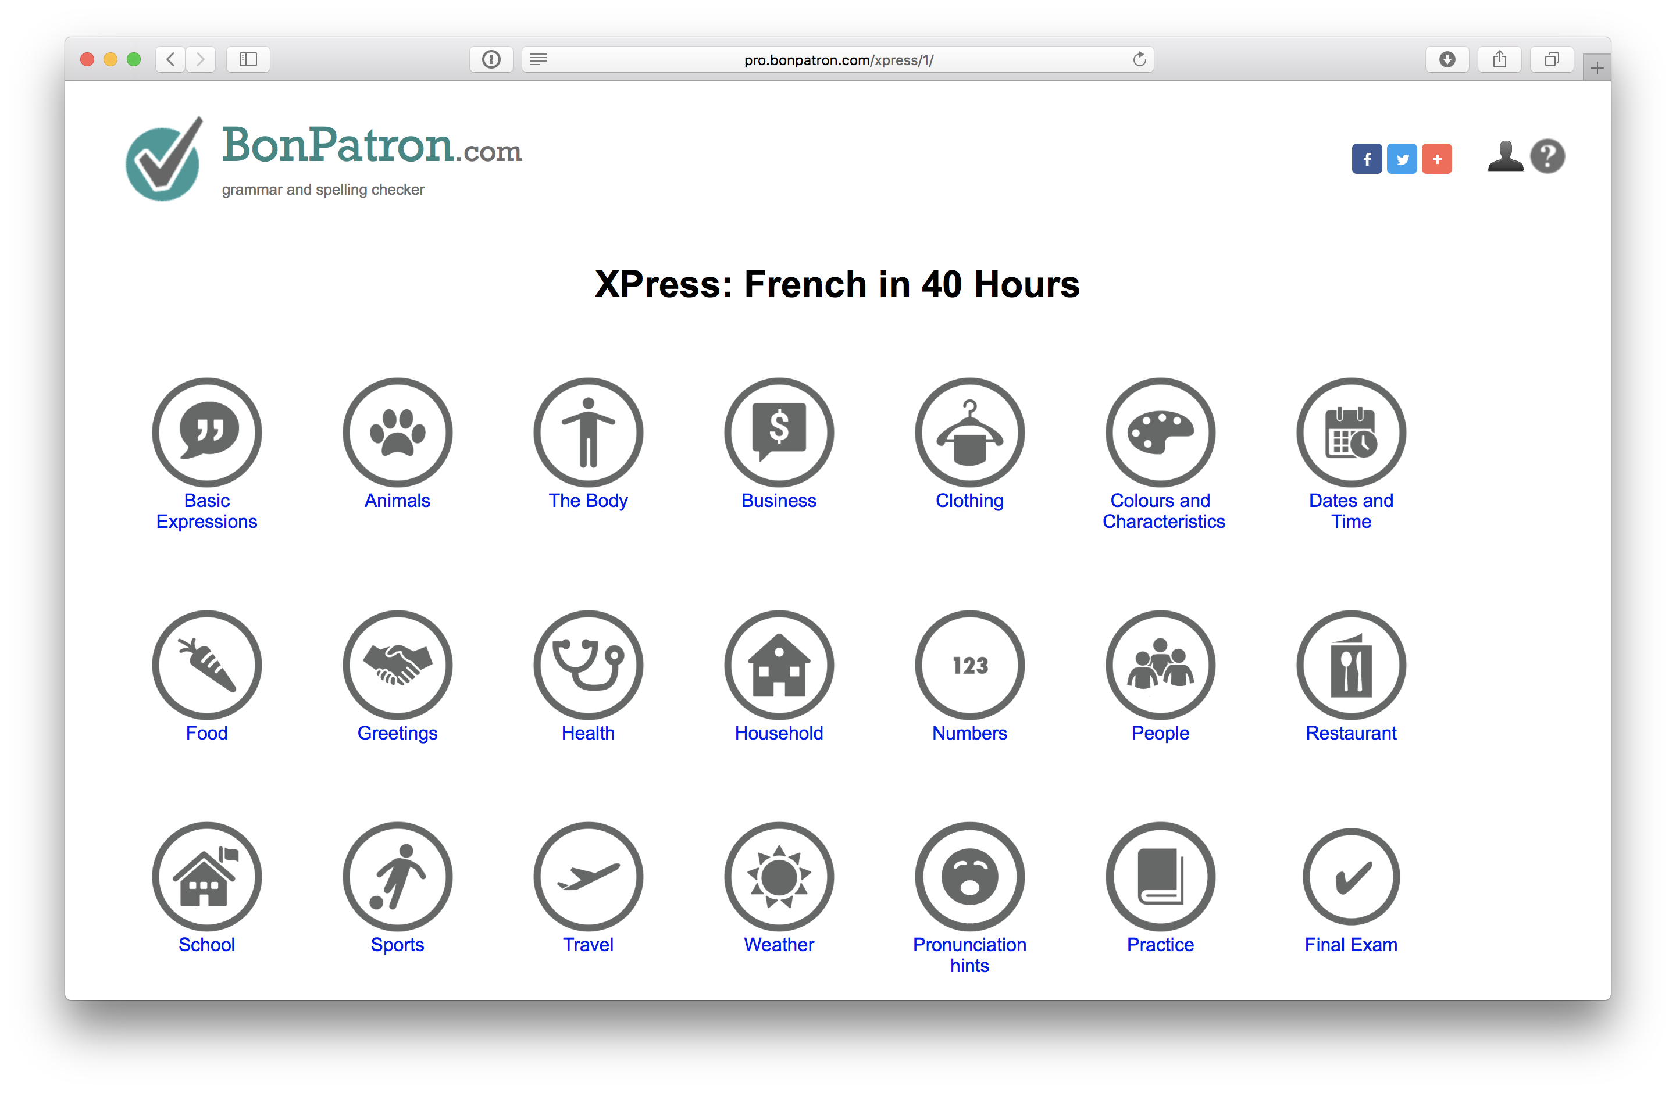
The BonPatron Vocabulary Guide

Slide 2
The BonPatron Vocabulary Guide
Who is it for?
What is it?
How can I use it with my students?

Slide 3
Who is it for?
Core French students of all ages
It is especially helpful for beginner and intermediate learners.
It can be used in a classroom setting or for individual study

Slide 4
What is it?
It’s an interactive resource for vocabulary building
You can base an entire course on it
It contains 500 frequent words/expressions
It promotes deep learning of the words

Slide 5
What is Deep Learning?
In order to really learn a word, students need to:
Link the word to meaning
Link the word to sound
Link the word to writing
Produce the word spontaneously

Slide 6
What is it?
The guide’s 500 words are divided into familiar thematic units, e.g.:
Greetings, health, sports, school, household, etc.
Here’s a screenshot…

Slide 7
What is it?

Slide 8
What is it?
In addition to word tables, you’ll find:
Simple exercises (with answers)
Key grammatical points
A game
Simple translation tasks (with answers)
Here’s a screenshot…

Slide 9
What is it?

Slide 10
Here’s the demo!
Let’s go have a look: https://bonpatron.com/xpress/1/

Slide 11
The Tennis Game
Tests ability to quickly produce a word
See the word, type it and get a point
You can control the speed at which words appear
Idea: create two teams, but have the teacher be the typist.

Slide 12
Learning in 9 Steps (or X steps)
Here’s one possible sequence to consider (and an idea for classroom activities)
Step 1: reveal English and French (initial association)
Step 2: hide English (memory exercise; L2 > L1)
Step 3: hide French (memory exercise L1 > L2)

Slide 13
Learning in 9 Steps
Step 4: hide French, write out word (production + writing; L1 > L2)
Step 5: reveal Eng./French and listen to sound (link written to spoken)
Step 6: listen and repeat sound (spoken production)

Slide 14
Learning in 9 Steps
Step 7: hide French, listen to sound, write out word (production; link sound to written)
Step 8: hide English and French, listen to sound, write word (production; link sound to word)
Step 9: play the game (improve spontaneous production)

Slide 15
Integrating vocabulary acquisition with grammatical acquisition
grammar doesn’t exist by itself
“grammar” is what happens when you put words into action
only then do we know it’s ma + maison; je + suis
In French, grammar is mainly word order and agreement, e.g.: number, gender, tense, mood

Slide 16
From vocabulary to grammar
Even beginners can take knowledge from BonPatron’s vocabulary site, and:
Produce grammatical sentences with BonPatron’s grammar helper (and lexical tool and conjugator)
Consider a student who has learned the “Household words”, e.g.: house, bedroom, kitchen (you know, simple stuff)

Slide 17
From vocabulary to grammar
how might relative beginners produce a grammatical sentence like Ma maison a trois chambres et une grande cuisine
(“My house has three bedrooms and a big kitchen”)?

Slide 18
From vocabulary to grammar
They already have acquired the following:
My maison has three chambre and a big cuisine.

Slide 19
Integrating grammar (Household)
What they lack is:
a) a few more words
b) grammar (agreement, etc.)
My maison has three chambre and a big cuisine.

Slide 20
Integrating grammar (“Household”)
Let’s go over to BonPatron.com (the grammar helper) and see what might happen if they use the dictionary:
Mon maison avoir trois chambre and un grand cuisine.
If you run this through BonPatron.com, the red errors will all be explained
This should lead to the correct changes

Slide 21
Integrating grammar (composition)
The goal is not to produce flawless texts
It is to put learned words into action
And, learn grammar through this process

Slide 22
Practice Link
based on frequency
this is for extra vocab learning
a list of 105 nouns (with articles)
105 verbs (infinitives)

Slide 23
Practice Link
100 adjectives
60 prepositions and adverbs
feedback is given
answers can be revealed

Slide 24
Final Exam
Unlike the Practice link,
The Final exam is based entirely on the vocabulary guide
It should be a goal for any beginner French programme

Slide 25
Function words
Remember, the vocabulary guide focuses on content words (nouns, verbs, adjectives)
For function words (e.g.: prepositions, pronouns)
Use the BonPatron Grammar Guide:
https://bonpatron.com/guide/1/

Slide 26
Pronunciation hints
Help with basic problems, like:
Liaison
Nasals
French “u”
French “R”

Slide 27
Free versus PRO?
The PRO version allows for longer texts
Has a larger editing window
You avoid ads
You get a writing portfolio
You support the project

Slide 28
General conclusions
No need for random vocabulary lists
Learning an L2 should begin with vocabulary
BonPatron’s Vocabulary Guide provides an interactive tool, available to all.
Learned vocabulary should be the gateway to grammar

